Slide 1
PIP2001 Capstone Project
NAME | ROLL NO
G AKSHAY KUMAR | 20211CSE0468
P MOHAMMAD FAYAZ | 20211CSE0837
M LOKESH YADAV | 20211CSE0479
Big Data challenges for the e-Mobility
Under the Supervision of,
Dr. Joseph Michael Jerard V
Professor
School of Computer Science and Engineering
Presidency University
Name of the Program: B.Tech Computer Science and Engineering
Name of the HoD: Dr. Blessed Prince
Name of the Program Project Coordinator: Prof. Srinivas Mishra
Name of the School Project Coordinators: Dr. Sampath A K / Dr. Abdul Khadar A / Mr. Md Ziaur Rahman

Slide 2
INDEX
Abstract
Objective of project
Problem Statement
Scope And Motivation
Introduction
Literature survey
Existing Method
Disadvantages
Proposed method
Advantages
Project Flow
Hardware and Software Requirements
Modules
UML Diagram
Output Screens
Conclusion
Future Work
References

Slide 3
ABSTRACT
The "Data Challenges for E-Mobility" project focuses on creating a streamlined system to manage and improve the efficiency of electric vehicle (EV) infrastructure. The system comprises three modules: Admin, User, and EV Center. The Admin module allows administrators to log in, add EV charging centers, and address user complaints. Users can register, log in, and view nearby EV charging centers with location and calling options, ensuring convenience and accessibility. EV Center operators can log in to view and resolve complaints, enhancing service reliability. This project addresses key data management and operational challenges in the e-mobility sector. By fostering seamless communication between users, administrators, and EV centers, the platform ensures better service delivery and supports the adoption of sustainable EV solutions. It provides an innovative approach to tackle real-world issues in the growing field of electric mobility.
Keywords: E-Mobility, Electric Vehicle (EV) Infrastructure, EV Charging Centers, Data Management, Complaint Resolution, Sustainable Mobility, User Accessibility, Service Efficiency, Electric Mobility Solutions, EV Adoption Challenges

Slide 4
OBJECTIVE OF PROJECT
The objective of this project, "Data Challenges for E-Mobility," is to create an efficient platform for managing and improving EV infrastructure. It focuses on streamlining data management by enabling administrators to add and monitor EV charging centers effectively. Users are provided with tools to locate charging centers, view details, and contact them directly for convenience. The platform ensures efficient complaint resolution by facilitating communication between users, administrators, and operators. By addressing these challenges, the project aims to enhance user satisfaction and operational reliability, promoting the adoption of sustainable e-mobility solutions.

Slide 5
PROBLEM STATEMENT
The electric vehicle sector faces significant challenges in managing and optimizing EV charging infrastructure. There is a lack of effective systems for connecting users with nearby charging stations, handling complaints, and ensuring operational reliability. The absence of a streamlined communication platform between users, administrators, and charging center operators results in inefficiencies, poor user experience, and delayed resolution of issues. As e-mobility adoption grows, addressing these gaps becomes critical to supporting sustainable mobility and enhancing the overall EV ecosystem.

Slide 6
SCOPE
The project aims to develop a comprehensive platform that enhances the management and efficiency of electric vehicle (EV) infrastructure by integrating three core modules: Admin, User, and EV Center. The system will facilitate seamless interaction between EV users, administrators, and charging center operators to improve service delivery, resolve complaints, and ensure accessibility to EV charging stations. It will address challenges related to data management, operational efficiency, and the growing demand for EV infrastructure. The platform also aims to foster greater adoption of electric vehicles through user-friendly features and better service reliability. This solution targets both current and future needs in the expanding e-mobility sector.

Slide 7
MOTIVATION
The motivation behind this project stems from the growing need to support the transition to sustainable transportation through electric vehicles (EVs). As EV adoption accelerates, the efficiency and accessibility of charging infrastructure become crucial to ensuring widespread use. By developing a streamlined system for managing EV charging centers, the project aims to solve real-world challenges in service delivery and user convenience. Addressing these gaps will not only improve the user experience but also foster greater trust and confidence in electric mobility. Ultimately, the project contributes to the global goal of reducing carbon emissions and promoting greener transportation solutions.

Slide 8
INTRODUCTION
The rapid growth of electric vehicles (EVs) is revolutionizing the automotive industry and contributing to global efforts for a sustainable, low-carbon future. As governments, organizations, and individuals increasingly adopt EVs, the demand for reliable and efficient charging infrastructure has surged. However, despite the growing popularity of electric mobility, the existing EV charging infrastructure faces significant challenges in terms of accessibility, reliability, and user experience. These issues, if left unaddressed, can hinder the widespread adoption of electric vehicles and delay the transition to greener transportation solutions. The platform consists of three key modules: Admin, User, and EV Center. The Admin module allows administrators to manage the platform, add new charging stations, and resolve user complaints. The User module enables EV owners to register, log in, and easily locate nearby charging stations, while also providing options for direct communication with the charging centers. The EV Center module allows operators to view and resolve user complaints, ensuring a seamless and efficient service experience.

Slide 9
INTRODUCTION
By bridging the gap between EV users, charging center operators, and administrators, this system will improve service reliability, optimize charging station usage, and enhance overall user satisfaction. The platform also supports better data management, making it easier to track and address issues related to charging stations. Ultimately, the project aims to foster greater adoption of electric vehicles, contributing to the global effort to combat climate change and promote sustainable mobility solutions. Through this approach, the platform provides an innovative solution to real-world challenges in the growing e-mobility sector.

Slide 10
Literature Survey
S.NO. | Author | Title | Year | Outcome
1 | Chien, S., & Wei, C. | A Mobile App-based Smart EV Charging Management System | 2023 | Optimized EV charging scheduling and management for urban environments.
2 | Zhao, X., Liu, Y., & Wang, T. | Intelligent Mobile App for EV Infrastructure Management and User Convenience | 2022 | Improved management of EV charging stations, enhancing user accessibility and station performance.
3 | Chen, R., & Zhang, M. | Mobile-based Platform for Real-Time EV Charging Station Monitoring and Data Analytics | 2021 | Real-time data monitoring and analytics for more efficient EV station operation and maintenance.
4 | Gupta, P., & Bansal, S. | Optimizing EV Charging Stations with a Mobile Application for User Accessibility | 2023 | Improved access to EV charging stations with real-time updates, geolocation, and reviews.
5 | Patel, A., & Shah, N. | Design and Development of an EV Charging Station Management System Using Mobile App Integration | 2022 | Mobile app for managing bookings, payments, and efficient use of EV charging stations.

Slide 11
Modules
ADMIN: The Admin module allows administrators to log in, manage the system, add new EV charging centers, and view customer complaints.
USER: The User module enables users to register, log in, and view available EV charging centers along with their locations. Users can also access a calling option for direct communication with charging centers.
EV charging center: The EV Center module is dedicated to the charging center staff, enabling them to log in, view user complaints, and manage their resolutions. This system enhances the user experience by providing an intuitive platform for both the management and usage of EV charging infrastructure, while also ensuring efficient handling of complaints.

Slide 12
Existing method And Disadvantages
Existing Methods :
Traditional complaint handling systems rely on manual processes, making them time-consuming and error-prone. Standalone EV charging platforms and navigation apps focus on locating charging stations but lack features for real-time complaint resolution or communication. Dynamic charging management systems optimize station usage but neglect user-centric needs like feedback and issue tracking. Smart city complaint systems offer generalized solutions but fail to address e-mobility-specific challenges. These fragmented approaches highlight the need for an integrated platform that combines user accessibility, complaint resolution, and efficient administrative management tailored to the e-mobility ecosystem. This project addresses these gaps comprehensively.
Disadvantages :
Manual complaint-handling systems are inefficient, prone to errors, and lack scalability for large-scale operations.
Dynamic EV charging management systems focus on optimization but require substantial computational resources and overlook user-centric features like real-time issue tracking.

Slide 13
Proposed method and Advantages
Proposed Method :
The proposed system is a unified platform designed to streamline e-mobility management by integrating admin, user, and EV center functionalities. Administrators can add and manage EV charging centers while addressing user complaints efficiently. Users can locate nearby charging stations, access location details, and directly contact the centers for support. EV center operators can view and resolve complaints in real time, ensuring service reliability. This system bridges the gaps in existing methods, providing a seamless, user-friendly, and efficient solution for managing e-mobility challenges.
Advantages :
Combines functionalities for users, administrators, and EV charging center operators in a single system, ensuring seamless communication and management.
Facilitates efficient handling of user complaints, improving response times and enhancing user satisfaction.
Provides intuitive tools for users to locate EV charging centers, view location details, and directly contact operators, ensuring accessibility and convenience.
Streamlines the management of EV charging infrastructure, reducing manual errors and improving system reliability.
Designed to handle the growing demand for e-mobility infrastructure while maintaining high performance and usability.

Slide 14
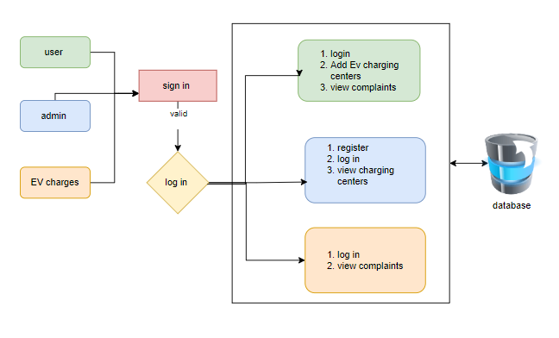
PROJECT FLLOW

Slide 15
HARDWARE & SOFTWARE REQUIREMENTS
SOFTWARE REQUIREMENS
Operating System - Windows 10
JDK - Java (kotlin)
SDK - Android
IDE - Android studio
Database - my SQL

Slide 16
HARDWARE & SOFTWARE REQUIREMENTS
HARDWARE REQUIREMENTS
Processor - I3/Intel Processor
RAM - 8 GB
Hard Disk - 1TB

Slide 17
UML DIAGRAMS
Use Case Diagram:
A use case diagram in the Unified Modeling Language (UML) is a type of behavioral diagram defined by and created from a Use-case analysis. Its purpose is to present a graphical overview of the functionality provided by a system in terms of actors, their goals (represented as use cases), and any dependencies between those use cases. The main purpose of a use case diagram is to show what system functions are performed for which actor. Roles of the actors in the system can be depicted.

Slide 18
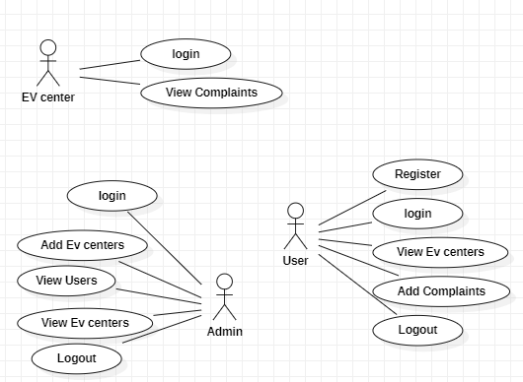
UML Diagrams
Use Case Diagram
Figure: Use Case Diagram

Slide 19
UML Diagrams
UML DIAGRAMS
Sequence Diagram:
A sequence diagram in Unified Modelling Language (UML) is a kind of interaction diagram that shows how processes operate with one another and in what order. It is a construct of a Message Sequence Chart. Sequence diagrams are sometimes called event diagrams, event scenarios, and timing diagrams.

Slide 20
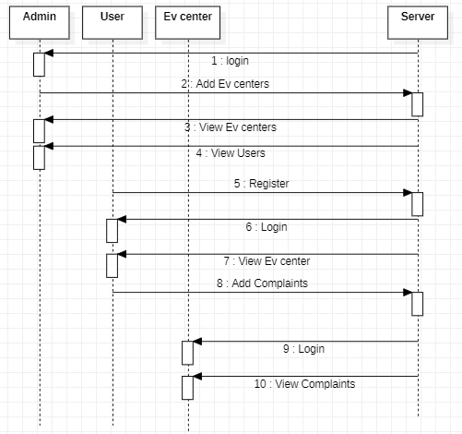
UML DIAGRAMS
Figure: Sequence diagram

Slide 21
UML DIAGRAMS
Collaboration Diagram:
In collaboration diagram the method call sequence is indicated by some numbering technique as shown below. The number indicates how the methods are called one after another. We have taken the same order management system to describe the collaboration diagram. The method calls are similar to that of a sequence diagram. But the difference is that the sequence diagram does not describe the object organization whereas the collaboration diagram shows the object organization.

Slide 22
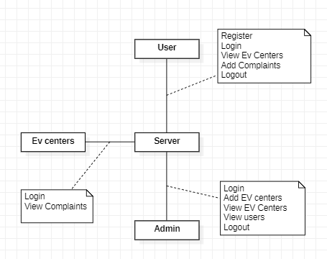
UML Diagrams
Figure: Collaboration diagram

Slide 23
UML DIAGRAMS
Deployment Diagram :
Deployment diagram represents the deployment view of a system. It is related to the component diagram. Because the components are deployed using the deployment diagrams. A deployment diagram consists of nodes. Nodes are nothing but physical hardware’s used to deploy the application.

Slide 24
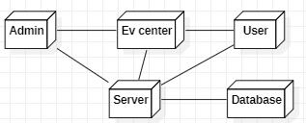
UML DIAGRAMS
Figure: Deployment diagram

Slide 25
UML DIAGRAMS
Activity Diagram:
Activity diagrams are graphical representations of workflows of stepwise activities and actions with support for choice, iteration and concurrency. In the Unified Modelling Language, activity diagrams can be used to describe the business and operational step-by-step workflows of components in a system. An activity diagram shows the overall flow of control.

Slide 26
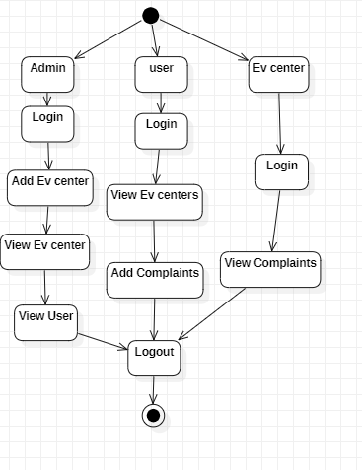
UML DIAGRAMS
Figure: Activity diagram

Slide 27
UML DIAGRAMS
Component Diagram:
A component diagram, also known as a UML component diagram, describes the organization and wiring of the physical components in a system. Component diagrams are often drawn to help model implementation details and double-check that every aspect of the system's required functions is covered by planned development.

Slide 28
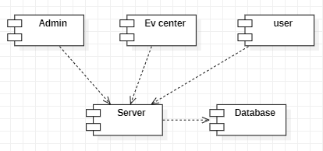
UML DIAGRAMS
Figure: Component diagram

Slide 29
UML DIAGRAMS
ER Diagram:
An Entity–relationship model (ER model) describes the structure of a database with the help of a diagram, which is known as Entity Relationship Diagram (ER Diagram). An ER model is a design or blueprint of a database that can later be implemented as a database. The main components of E-R model are: entity set and relationship set.
An ER diagram shows the relationship among entity sets. An entity set is a group of similar entities and these entities can have attributes. In terms of DBMS, an entity is a table or attribute of a table in database, so by showing relationship among tables and their attributes, ER diagram shows the complete logical structure of a database. Let’s have a look at a simple ER diagram to understand this concept.

Slide 30
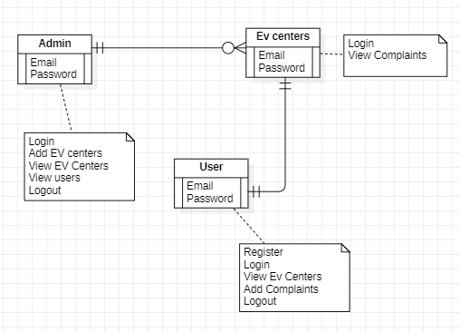
UML DIAGRAMS
Figure: ER diagram

Slide 31
UML DIAGRAMS
DFD Diagram:
A Data Flow Diagram (DFD) is a traditional way to visualize the information flows within a system. A neat and clear DFD can depict a good amount of the system requirements graphically. It can be manual, automated, or a combination of both. It shows how information enters and leaves the system, what changes the information and where information is stored. The purpose of a DFD is to show the scope and boundaries of a system as a whole. It may be used as a communications tool between a systems analyst and any person who plays a part in the system that acts as the starting point for redesigning a system.

Slide 32
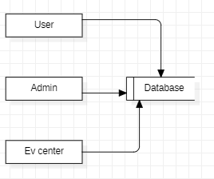
UML DIAGRAMS
Figure: DFD diagram

Slide 33
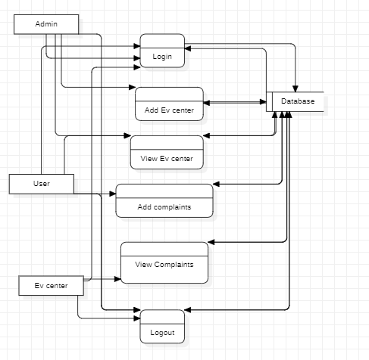
UML DIAGRAMS
Figure: DFD diagram

Slide 34
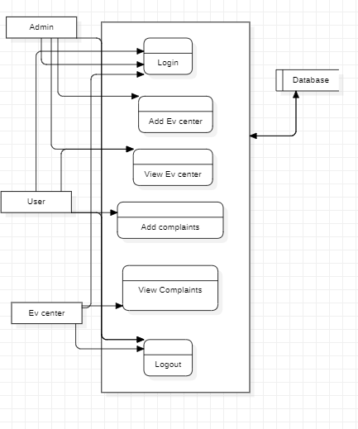
UML DIAGRAMS
Figure: DFD diagram

Slide 35


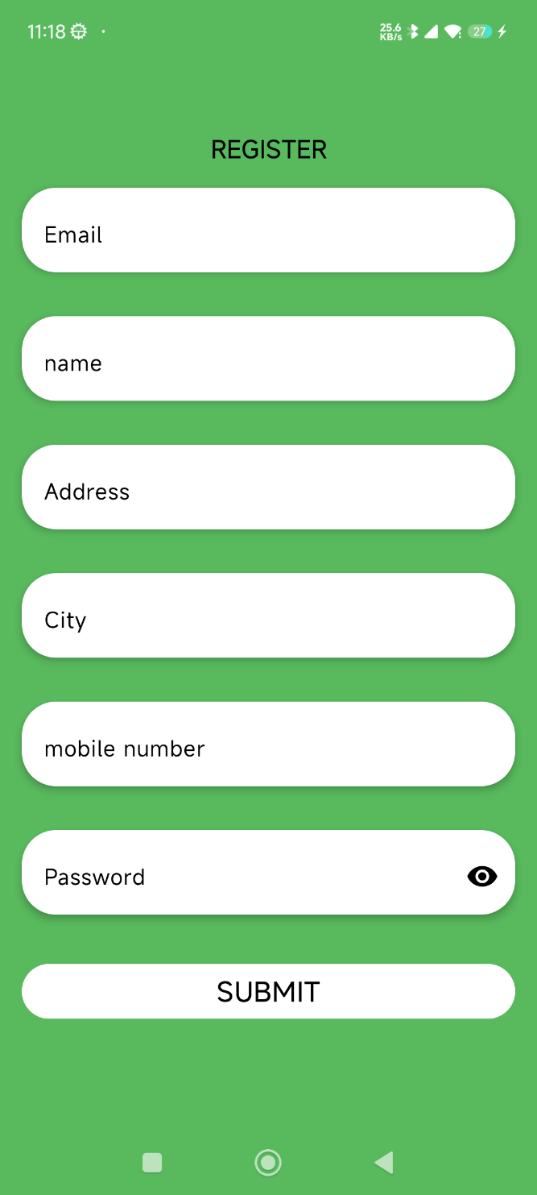
OUTPUT SCREENS

Slide 36
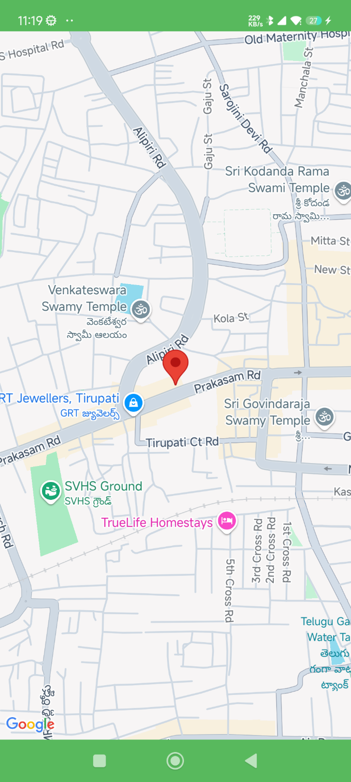
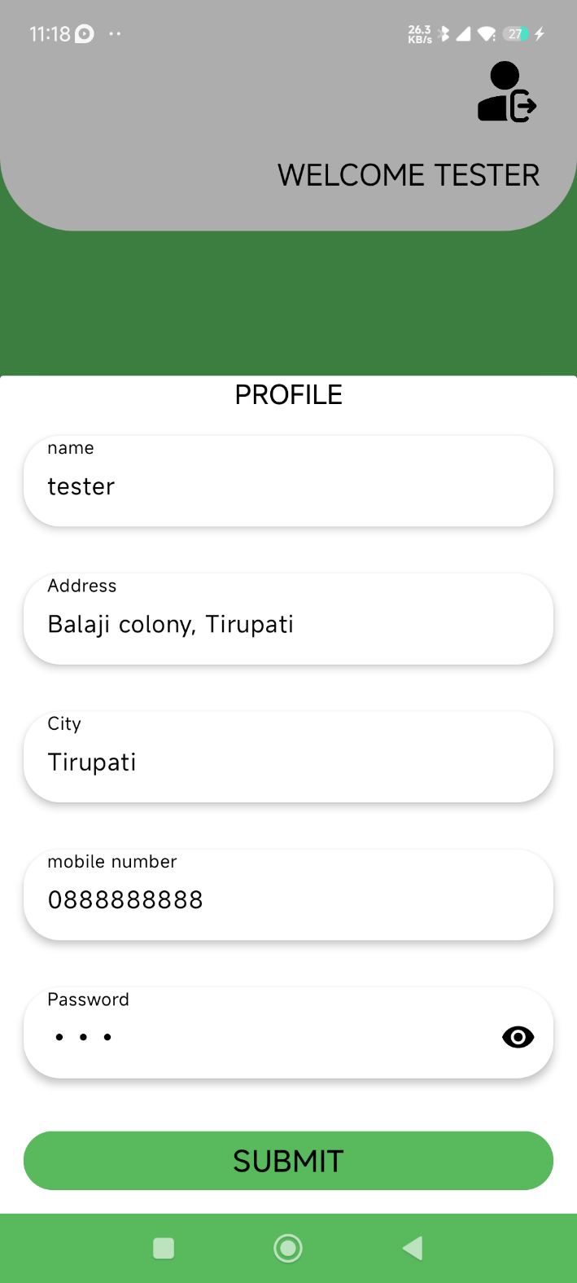

OUTPUT SCREENS

Slide 37
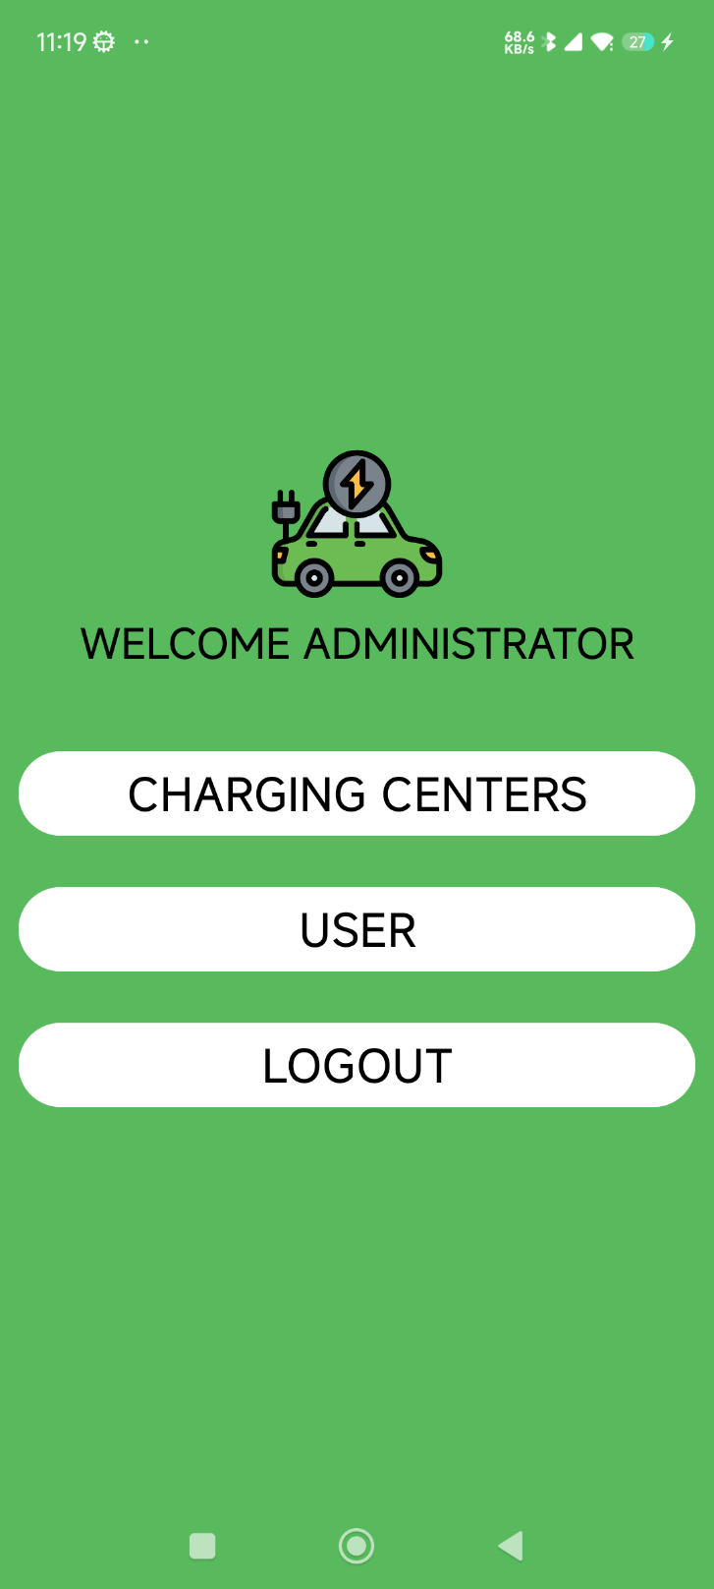
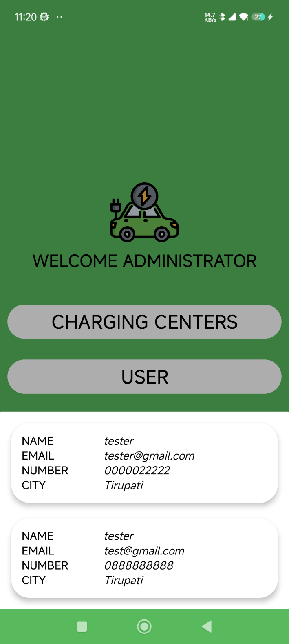
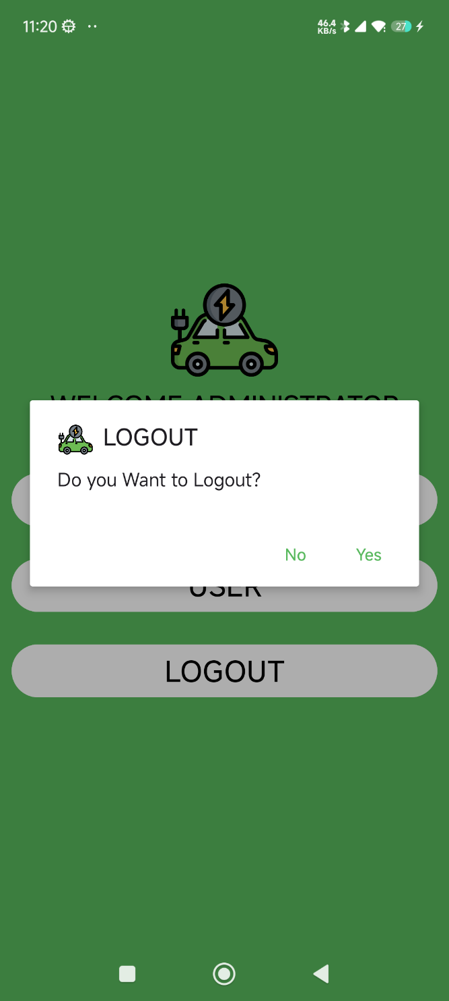
OUTPUT SCREENS

Slide 38
CONCLUSION
The "Data Challenges for E-Mobility" project addresses critical issues in the growing electric vehicle (EV) sector, particularly in the management and optimization of charging infrastructure. By creating an integrated platform that connects users, administrators, and charging center operators, the project aims to enhance the efficiency, accessibility, and reliability of EV charging services. Through the Admin, User, and EV Center modules, the system ensures smooth communication, timely complaint resolution, and better management of charging stations. These improvements ultimately contribute to a better user experience and greater adoption of electric vehicles, helping to advance the global transition to sustainable mobility solutions.The platform not only tackles operational inefficiencies but also supports data-driven decision-making, enabling administrators to monitor usage trends and address issues proactively. This streamlined approach helps enhance service delivery and ensures that EV owners have access to the charging infrastructure they need, when they need it. As the EV market continues to expand, this system provides a crucial tool for managing the complex dynamics of the evolving e-mobility landscape.

Slide 39
FUTURE ENHANCEMENT
Future enhancements to the "Data Challenges for E-Mobility" project could focus on expanding the platform's capabilities and improving its integration with emerging technologies in the e-mobility sector. One potential enhancement is the inclusion of real-time charging station availability and dynamic pricing models based on demand, allowing users to view current availability and adjust their charging plans accordingly. The system could also integrate with advanced navigation tools to provide users with optimal routes based on charging station locations and the vehicle's remaining battery life. To enhance user experience, features like EV-specific parking spot reservations and notifications for charging completion could be incorporated.
Moreover, the platform could be expanded to support multi-modal transportation systems, such as e-bikes, scooters, and public electric transport, allowing users to view all electric mobility options in a single interface. As electric vehicle technology advances, the platform could incorporate smart grid integration, enabling EV charging stations to interact dynamically with the power grid, optimizing energy usage and reducing costs during peak demand times. Incorporating machine learning algorithms to predict and manage charging patterns based on user behavior and historical data could further improve the efficiency of the network.

Slide 40
REFERENCES
Chien, S., & Wei, C. (2023). "A Mobile App-based Smart EV Charging Management System." Journal of Sustainable Transportation, 27(4), 510-526.
Zhao, X., Liu, Y., & Wang, T. (2022). "Intelligent Mobile App for EV Infrastructure Management and User Convenience." International Journal of Electric and Hybrid Vehicles, 20(2), 75-93. Chen, R., & Zhang, M. (2021). "Mobile-based Platform for Real-Time EV Charging Station Monitoring and Data Analytics." IEEE Transactions on Smart Grid, 12(6), 5500-5508. Gupta, P., & Bansal, S. (2023). "Optimizing EV Charging Stations with a Mobile Application for User Accessibility." Energy Reports, 9, 110-122.
Patel, A., & Shah, N. (2022). "Design and Development of an EV Charging Station Management System Using Mobile App Integration." Journal of Electrical Engineering & Technology, 17(3), 1021-1030.

Slide 41
REFERENCES
Wang, Z., & Liu, F. (2021). "A Data-driven Mobile App Solution for Electric Vehicle Charging Network Expansion." Renewable and Sustainable Energy Reviews, 145, 126-137. Lee, K., & Park, Y. (2022). "User-Centric EV Charging Services through a Mobile Application." Transportation Research Part C: Emerging Technologies, 132, 103407. Singh, R., & Gupta, A. (2023). "Smart EV Charging with Mobile App Integration for Smart City Applications." Smart Cities, 5(1), 34-49. Mishra, S., & Jain, M. (2021). "Mobile App for Secure EV Charging Transactions." IEEE Access, 9, 45322-45335. Yuan, X., & Chen, X. (2022). "Mobile Application for EV Charging Network Optimization: A Case Study." Sustainable Energy, Grids and Networks, 28, 100506.

Slide 42


